Slide 1
Parallel programs
Inf-2202 Concurrent and Data-intensive Programming
Fall 2016
Lars Ailo Bongo (larsab@cs.uit.no)

Slide 2
Course topics
Parallel programming
  The parallelization process
  Optimization of parallel programs
Performance analysis
Data-intensive computing

Slide 3
Parallel programs
Supercomputing
  Scientific applications
    Parallel programming was hard
    Parallel architectures were expensive
  Still important!
Data intensive computing
  Will return to this topic
Server applications
  Databases, Web servers, App servers, etc
Desktop applications
  Games, image processing, etc
Mobile phone applications
  Multimedia, sensor based, etc
GPU and hardware accelerator applications

Slide 4
Outline
Parallel architectures
Fundamental design issues
Case studies
Parallelization process
Examples

Slide 5
Parallel architectures
A parallel computer is “a collection of processing elements that communicate and cooperate to solve large problems fast” (Almasi and Gottlieb, 1989)
  Conventional computer architecture
  + communication among processes
  + coordination among processes
Notes:
Highly parallel computing (book), Almasi and Gottlieb, 1989.

Slide 6
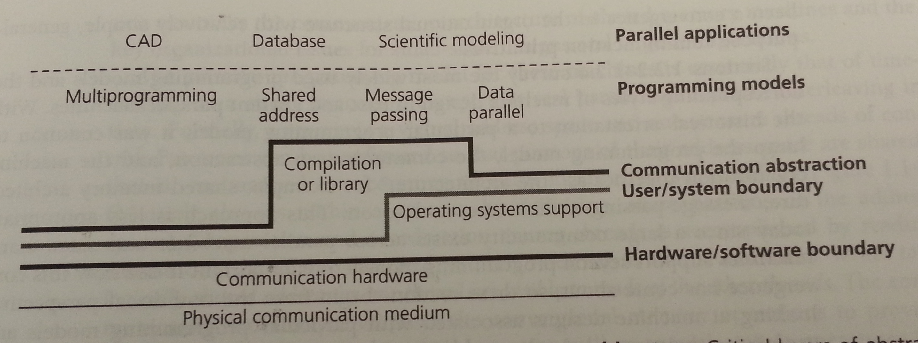
Communication architecture
Hardware/ software boundary?
User/ system boundary?
Defines:
  Basic communication operations
  Organizational structures to realize these operations

Slide 7
Parallel architectures
Shared address space
Message passing
Data parallel processing
  Bulk synchronous processing (Valiant 1990)
  Google’s Pregel (Malewicz, et al., 2010)
  MapReduce (Dean & Ghemawat, 2010) and Spark (Zaharia et al, 2012)
Dataflow architectures (wikipedia1, wikipedia2)
  VHDL, Verilog, Linda, Yahoo Pipes(?), Galaxy (?)
Notes:
BSP: http://dl.acm.org/citation.cfm?id=79181&CFID=355958399&CFTOKEN=92782375
Pregel: dl.acm.org/citation.cfm?id=1807184
BSV: http://dl.acm.org/citation.cfm?id=2442995
J. Dean and S. Ghemawat, “MapReduce: a flexible data processing tool,” Commun. ACM, vol. 53, no. 1, p. 72, Jan. 20
M. Zaharia, M. Chowdhury, T. Das, A. Dave, J. Ma, M. McCauley, M. J. Franklin, S. Shenker, and I. Stoica, “Resilient distributed datasets: a fault-tolerant abstraction for in-memory cluster computing,” in NSDI’12 Proceedings of the 9th USENIX conference on Networked Systems Design and Implementation, 2012.
Wikipedia1: http://en.wikipedia.org/wiki/Dataflow_architecture
Wikipedia2: http://en.wikipedia.org/wiki/Dataflow_programming

Slide 8
Outline
Parallel architectures
Fundamental design issues
Case studies
Parallelization process
Examples

Slide 9
Fundamental design issues
Communication abstraction
Programming model requirements
Naming
Ordering
Communication and replication
Performance

Slide 10
Communication abstractions
Well defined operations
Suitable for optimization
Communication abstractions in Pthreds? Go?

Slide 11
Programming model
One or more threads of control operating on data
What data can be named by which threads
What operations can be performed on the named data
What ordering exists among those operations
Programming model for a uniprocessor?
Pthreads programming model?
Go programming model
Why need for explicit synchronization primitives?

Slide 12
Naming
Critical at each level of the architecture

Slide 13
Operations
Operations that can be performed on the data
Pthreads?
Go?
More exotic?

Slide 14
Ordering
Important at all layers in the architecture
Performance tricks
If implicit ordering is not enough; need synchronization:
  Mutual exclusion
  Events / condition variables
    Point-to-point
    Global
  Channels?

Slide 15
Communication and replication
Related to each other
Caching
IPC
Binding of data:
  Write
  Read
  Data transfer
  Data copy
  IPC

Slide 16
Performance
Data types, addressing modes, and communication abstractions specifies naming, ordering and synchronization for shared objects
Performance characteristics specifies how they are actually used
Metrics
  Latency: the time for an operation
  Bandwidth: rate at which operations are performed
  Cost: impact on execution time

Slide 17
Outline
Parallel architectures
Fundamental design issues
Case studies
Parallelization process
Examples
Notes:
BLAST
KNNImpute
Deduplication engine

Slide 18
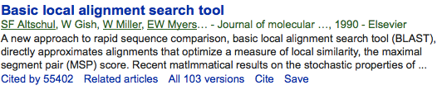

The Basic Local Alignment Search Tool (BLAST)
BLAST finds regions of local similarity between sequences. The program compares nucleotide or protein sequences to sequence databases and calculates the statistical significance of matches.
Popular to use
Popular to parallelize

Slide 19
Nearest neighbor equation solver
Example from chapter 2.3 in Parallel Computer Architecture: A Hardware/Software Approach. David Culler, J.P. Singh, Anoop Gupta. Morgan Kaufmann. 1998.
Common matrix based computation
Well known parallel benchmark (SOR)
Exercise

Slide 20
Deduplication
Mandatory assignment 2

Slide 21
Outline
Parallel architectures
Fundamental design issues
Case studies
Parallelization process
Examples

Slide 22
Parallelization process
Goals:
  Good performance
  Efficient resource utilization
  Low developer effort
May be done at any layer

Slide 23
Parallelization process (2)
Task: piece of work
Process/thread: entity that performs the work
Processor/core: physical processor cores

Slide 24
Parallelization process (3)
Decomposition of the computation into tasks
Assignment of tasks to processes
Orchestration of necessary data access, communication, and synchronization among processes
Mapping of processes to cores

Slide 25
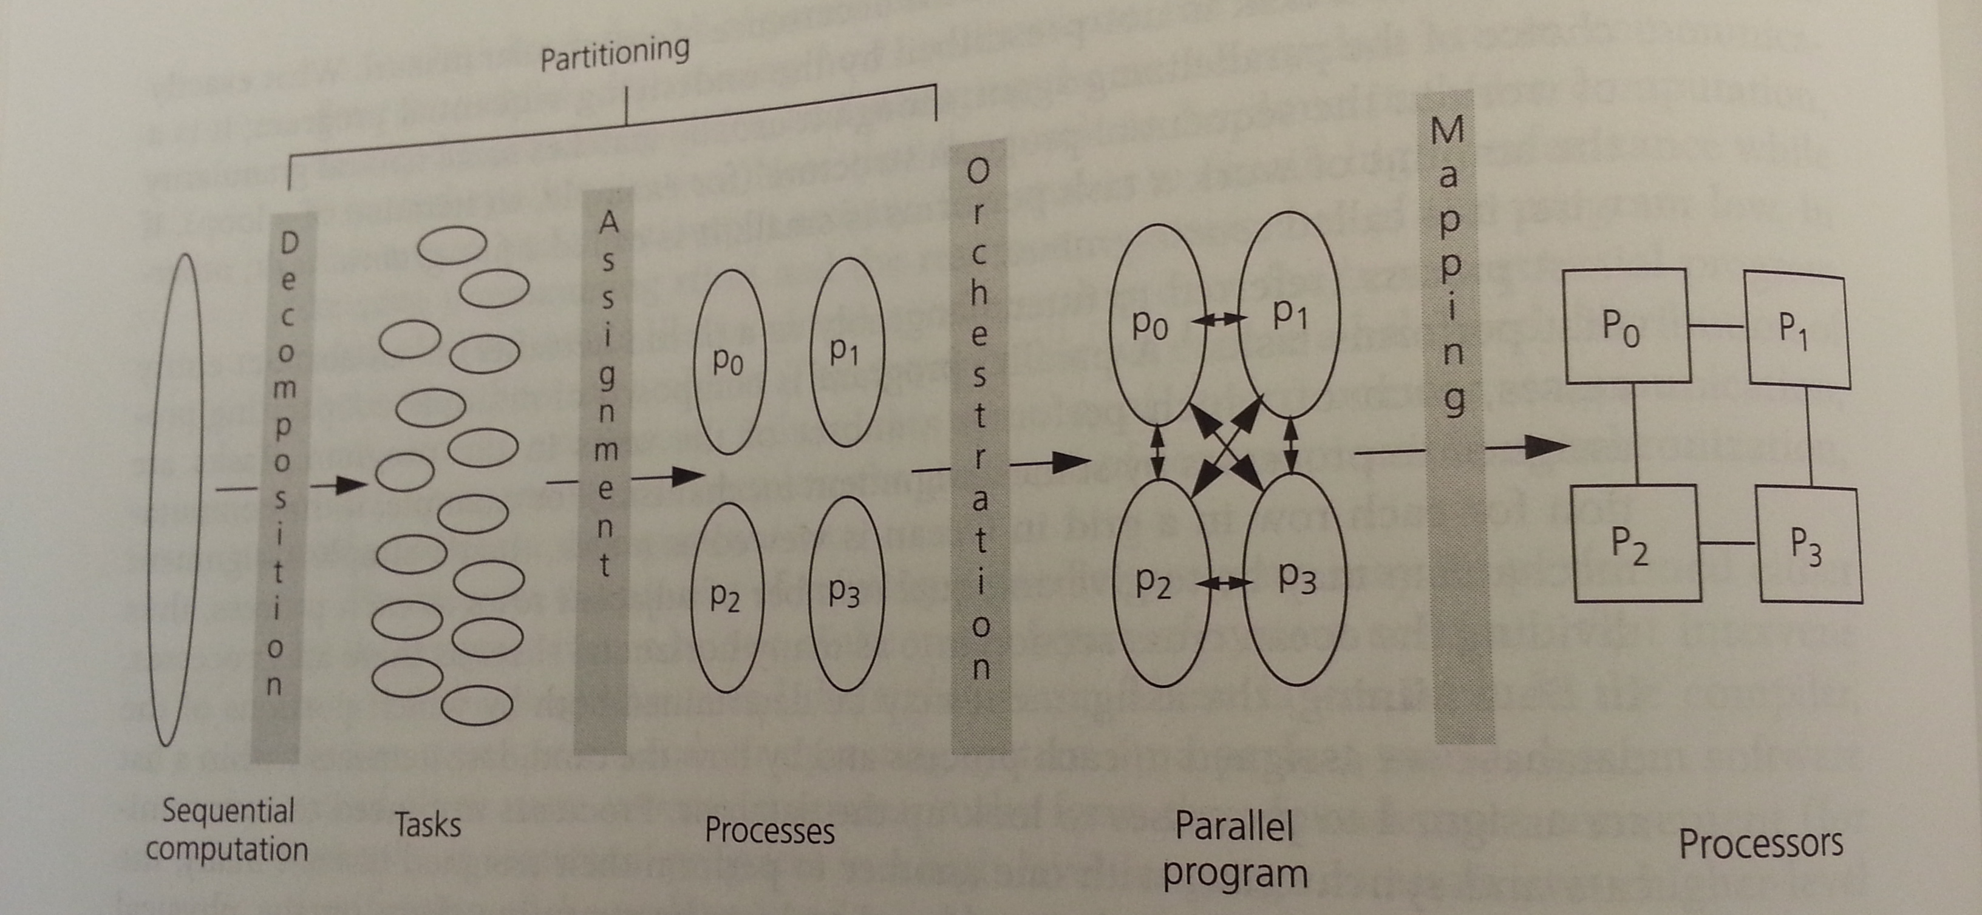
Steps in the parallelization process

Slide 26
Decomposition
Split computation into a collection of tasks
Algorithmic
Task granularity limits parallelism
➔ Amdahl’s law

Slide 27
Assignment
Algorithmic
Goal: load balancing
  All processes should do equal amount of work
  Important for performance
Goal: reduce communication volume
  Send minimum amount of data
Two types:
  Static
  Dynamic

Slide 28
Orchestration
Specific to computer architecture, programming model, and programming language
Goals:
  Reduce communication cost
  Reduce synchronization cost
  Locality of data
  Efficient scheduling
  Reduce overhead

Slide 29
Mapping
Specific to system or programming environment
  Parallel system resource allocator
  Queuing systems
  OS scheduler

Slide 30
Goals of parallelization process
Step | Architecture dependent? | Major performance goals
Decomposition | Mostly no | Expose enough concurrency but not too much
Assignment | Mostly no | Balance workload Reduce communication volume
Orchestration | Yes | Reduce noninherent communication via data locality Reduce communication and synchronization cost as seen by the processor Reduce serialization to shared resources Schedule tasks to satisfy dependencies early
Mapping | Yes | Put related threads on the same core if necessary Exploit locality in chip and network topology

Slide 31
Summary
Fundamental design issues for parallel systems
How to write a parallel program
Examples

